Slide 1
Contemporary Data Mining Algorithms
Dr Kanishka Bhattacharya
Today
K-Nearest Neighbors (k-NN)
Tree based learning

Slide 2
Classification in BBC Data
We have iPlayer usage data
View information about 10,000 users in January
Whether they watched in February or not
We want to predict whether a BBC iPlayer will use the viewer again in February, given that he/she used the service in January.
We would like to understand who are the repeat customers.
This has implications for
Content production
Recommendation engines
Advertisement (although BBC has no ads)

Slide 3
Learning Objectives
Parametric vs non-parametric methods
Basics of K-NN Method
Classification versus prediction
How to choose K
Improving basic K-NN’s performance
Differences between K-NN and MLR
How to use Caret library

Slide 4

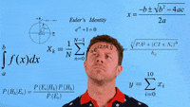
Today’s Agenda
K-Nearest Neighbor algorithm (k-NN)
“Tell me who your friends are, and I will tell you who you are.”
Lazy learning: a learning method in which generalization beyond the training data is delayed until a query is made to the system, as opposed to in eager learning, where the system tries to generalize the training data before receiving queries.
Nonparametric: It does not involve assumptions about the form of the relationship between dependent and independent variables.
Parametric approach will outperform the nonparametric approach if the parametric form that has been selected is close to the true form
We already used a similar idea in clustering
Notes:
Let’s reinvent the wheel
How can we learn from the neighbors?
What are the parameters?
What are the disadvantage?

Slide 5
Eager vs. lazy learners
Eager learners, when given a set of training tuples, will construct a generalization (i.e., classification) model before receiving new (e.g., test) tuples to classify.
We can think of the learned model as being ready and eager to classify previously unseen tuples
In lazy approach the learner instead waits until the last minute before doing any model construction in order to classify a given test tuple. That is, when given a training tuple, a lazy learner simply stores it (or does only a little minor processing) and waits until it is given a test tuple
Lazy learners can be computationally expensive. They require efficient storage techniques and are well-suited to implementation on parallel hardware. They offer little explanation or insight into the structure of the data.
Lazy learners, however, naturally support incremental learning. They are able to model complex decision spaces.
They can automatically capture changes in the operating environment
It has since been widely used in the area of pattern recognition.
Also used in movie and music recommendation systems, eg. Pandora recommendation engine.

Slide 6
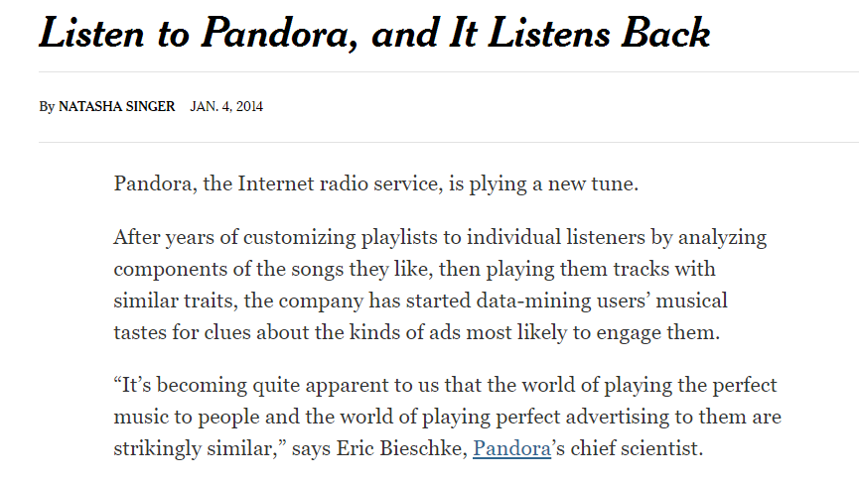
Pandora and ads
k-NN is used extensively in recommendation systems
Collaborative filtering: Find similar users and/or items.
Basket analysis: What goes with what.(not exactly k-NN)
Applications Amazon, Netflix, Pandora and etc.
Notes:
Let’s talk about a few examples
Does anyone used Pandora music service or something similar? What is it?
How do you think it works? They are based on assigning scores do music in 100 different dimensions and finding similar ones. So uses a k-nn algorithm. We will do this for scotch whiskies next week.
So this is similarity in songs. What other information can you use for making better reccomendations? We can use customer similarities, this is called collaborative filtering.
Who uses netflix? Do you know how they make reccomendations? Based on who you are similar to and how you rate?
What was it like before? While it was snail mail you had an incentive to rate but not people don’t rate as much because you can just stream. But you have more info what time which machine for how long
How about different countries? New markets?

Slide 7

When can this idea help?
When it is not possible to code independent variables in regression
Because of high dimensionality, eg. When trying to estimate a person’s music taste we might need many independent variables
Lack of data, eg. for a movie recommendation system we might not know the features of the movie but we can observe who liked it
It is possible to predict from similar items
Recommendation systems try to find customers that have similar preferences
Location data can be difficult to capture by regression.

Slide 8
Today’s agenda
k-NN
Introduction and basics
How to score new data
Distance metrics
How to choose k
kNN vs Multiple Linear Regression
Advantages and disadvantages of k-NN
Principal component analysis (AM11): Dimension reduction – Next week
How to use PCA with regression and k-NN
Notes:
Let’s see where we are in the sylabus

Slide 9
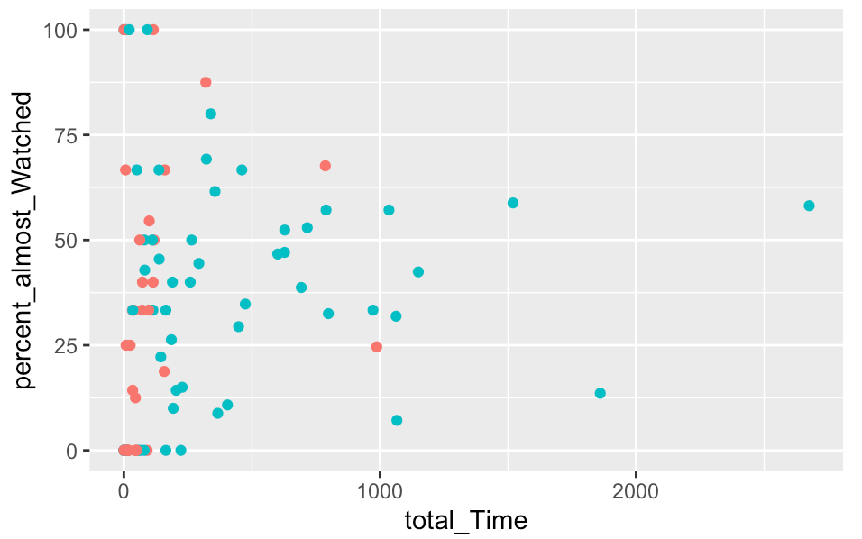
Basic idea
K=3
?
?

Slide 10
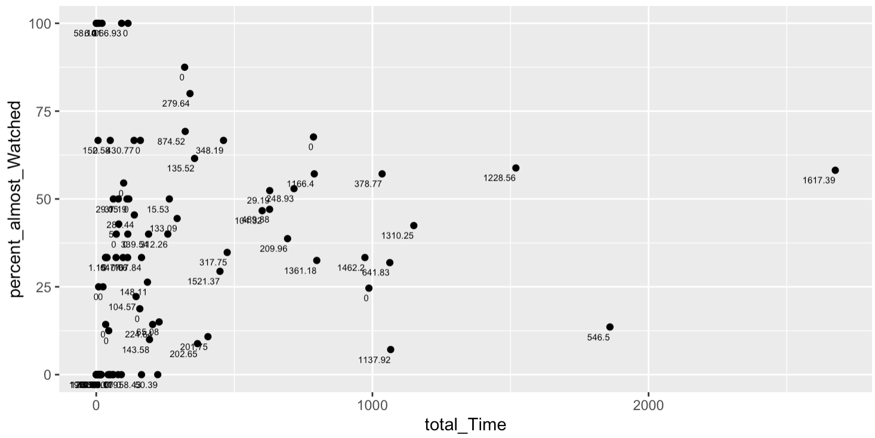
Basic idea
K=3
?

Slide 11
How to score new data
Now we know the neighbours, how do we predict the number of hours watched or whether the user engaged with iPlayer in February?
For classification
Use majority vote
You can also use the score if k is large (i.e >10). Then we can set-up the cut-off value using validation.
For prediction
Instead of “majority vote determines class” use average of response values
We can also use a weighted average, weight decreasing with distance
I will not cover this in this class but here is a link for the r library and additional documentation https://cran.r-project.org/web/packages/kknn/kknn.pdf

Slide 12
Normalizing
Problem: Raw distance measures are highly influenced by scale of measurements
Solution: normalize (standardize) the data first
Subtract mean, divide by std. deviation
Also called z-scores
We might event try with different weights for each variable
Example
Total_time =10,000
Average time =5,000
Standard deviation of time = 1,000
Scaled value=(10,000 -5,000)/ 1,000 =5

Slide 13
Choosing k: Low k vs. High k
K is the number of nearby neighbors to be used to classify the new record.
K=1 means use the single nearest record
K=5 means use the 5 nearest records
Typically choose that value of k which has lowest error rate in validation data.
Low values of k (1, 3, …) capture local structure in data (but also noise).
High values of k provide more smoothing, less noise, but may miss local structure.
Note: the extreme case of k = n (i.e., the entire data set) is the same as the “naïve rule” (classify all records according to majority class)

Slide 14
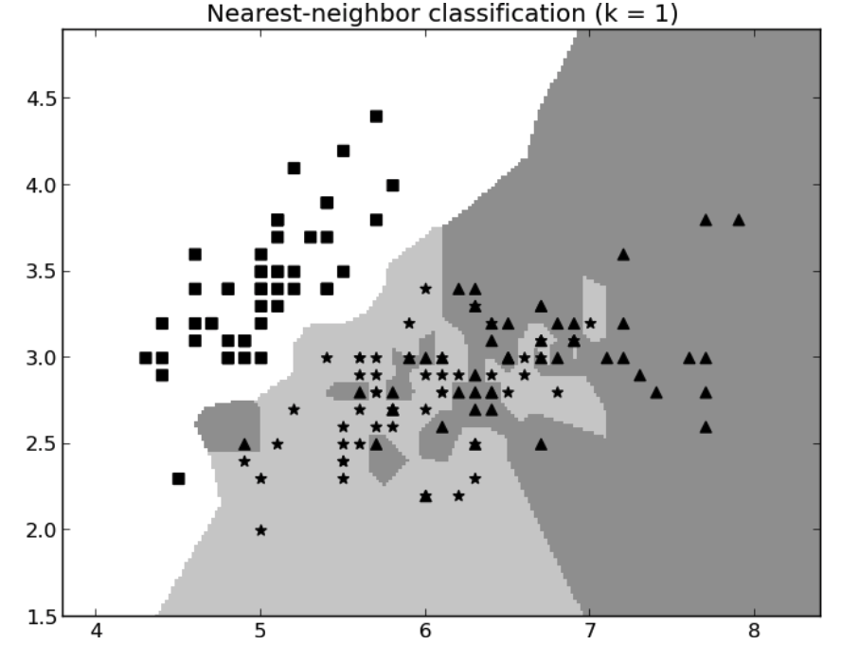
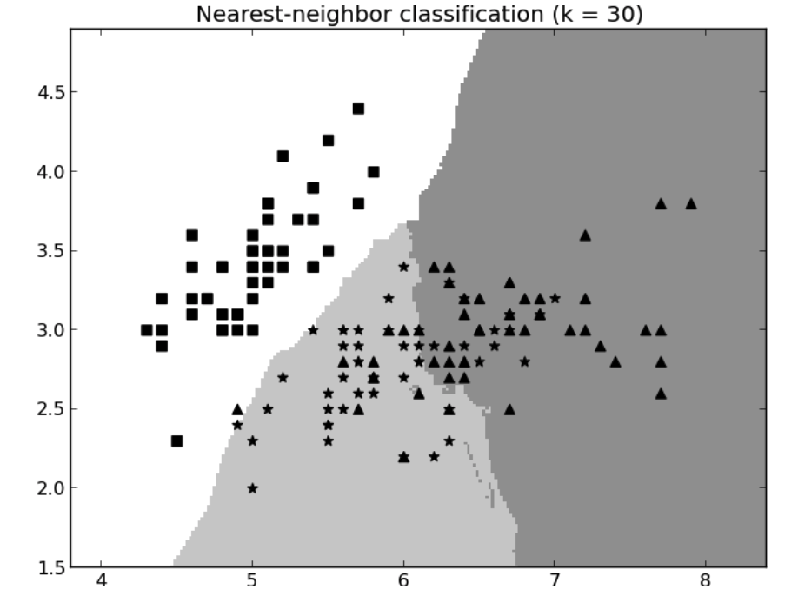
Example
A small value of K provides the most flexible fit but it may change significantly with a few additional data points
Larger values of K reduces variation but may miss local trends
When k small we need more samples when validating because variance is much higher

Slide 15
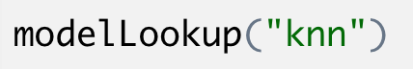
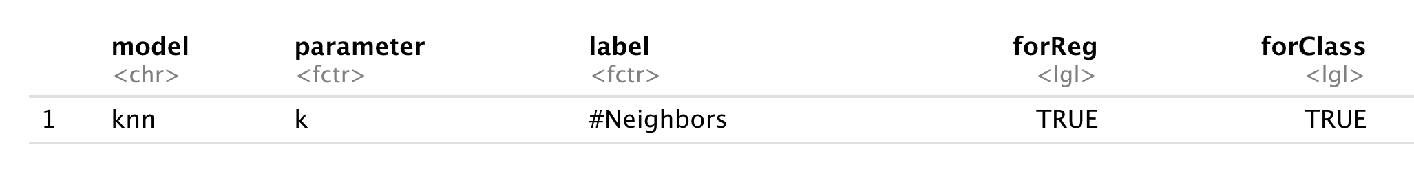
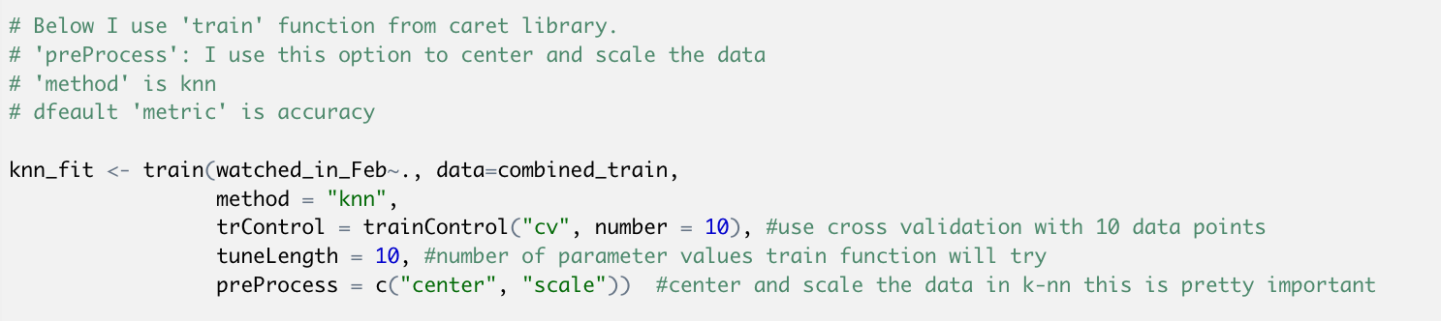
Implementing kNN using Caret
Tune-able parameters
List of methods
http://topepo.github.io/caret/train-models-by-tag.html

Slide 16
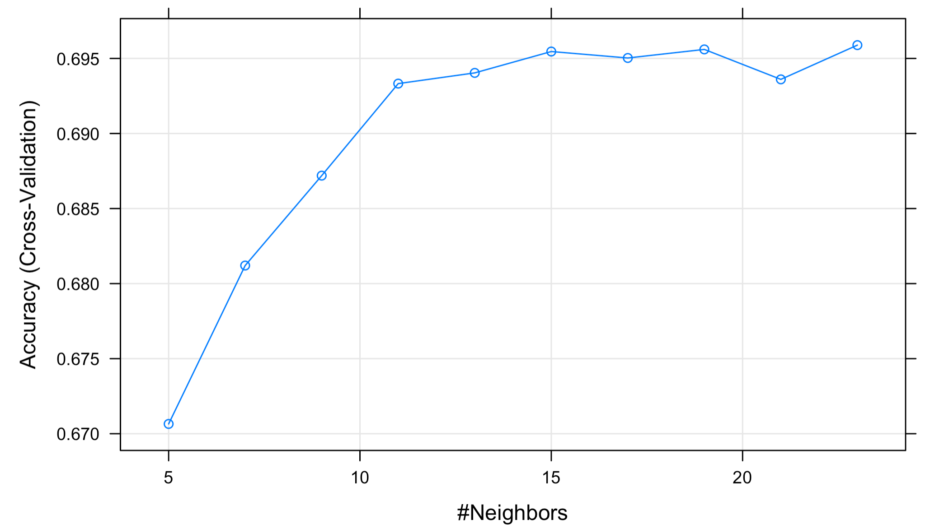
Result

Slide 17
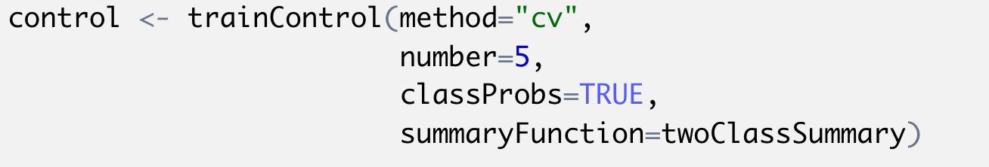
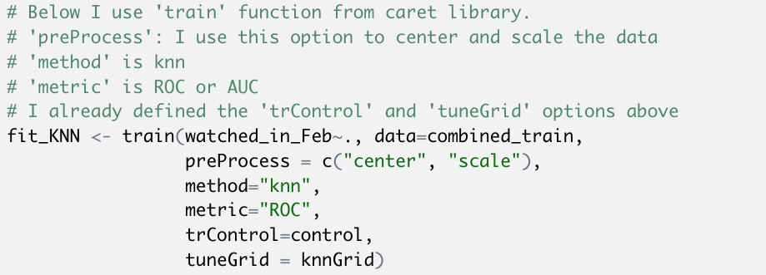
Implementing kNN using Caret
We need these options for classification metrics

Slide 18
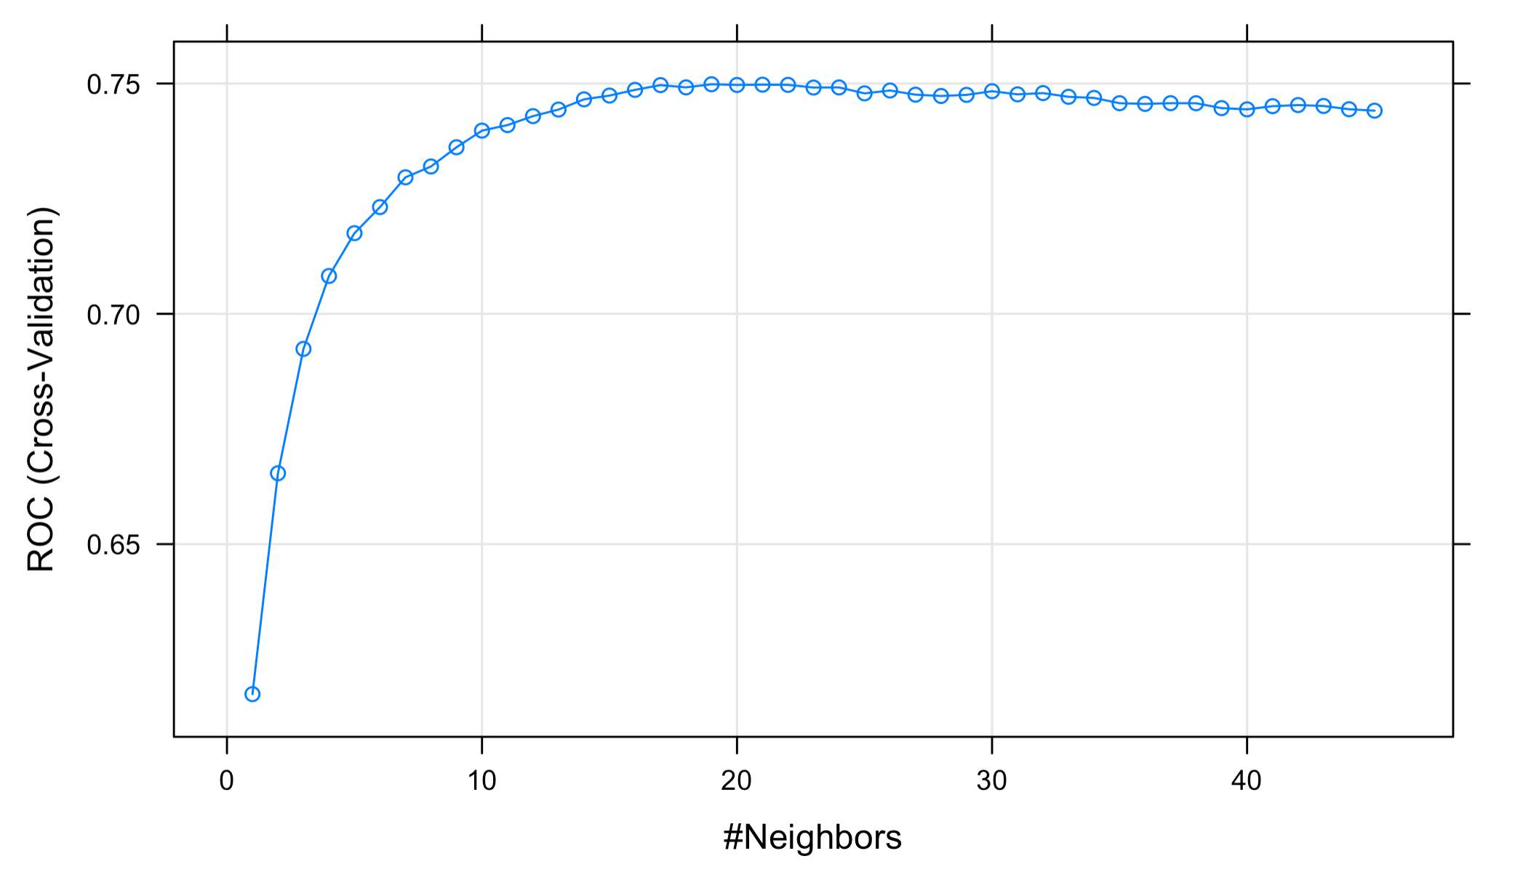
Results

Slide 19
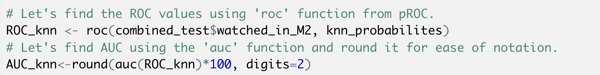
How do we check out of sample performance?
Predict the probabilities for testing data

Slide 20
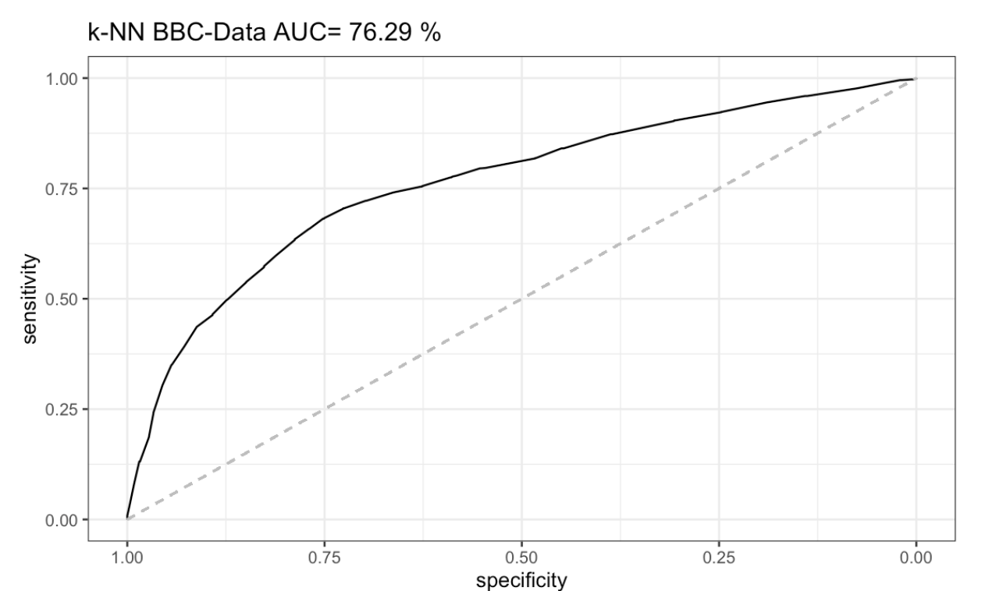
Result: ROC Chart

Slide 21
Today’s agenda
k-NN
Introduction and basics
How to score new data
Distance metrics
How to chose k
kNN vs MLR
Advantages and disadvantages of k-NN
Principal component analysis: Dimension reduction
How to use PCA with regression and k-NN
Notes:
Let’s see where we are in the sylabus

Slide 22
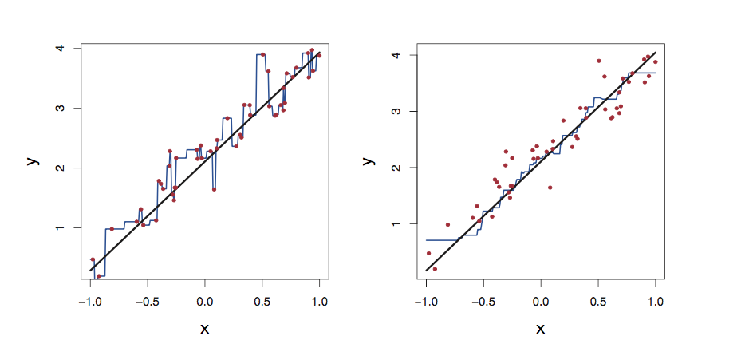

MLR vs k-NN
Let’s compare the performance of K-NN with multiple linear regression
Let’s assume that
$$y=2+2x+ε$$
Let’s fit a k-NN with k=1 and k=9, which one is better? Why?
Notes:
ˆ FIGURE 3.17. Plots of f(X) using KNN regression on a one-dimensional data
set with 100 observations. The true relationship is given by the black solid line. Left: The blue curve corresponds to K = 1 and interpolates (i.e. passes directly through) the training data. Right: The blue curve corresponds to K = 9, and represents a smoother fit.

Slide 23
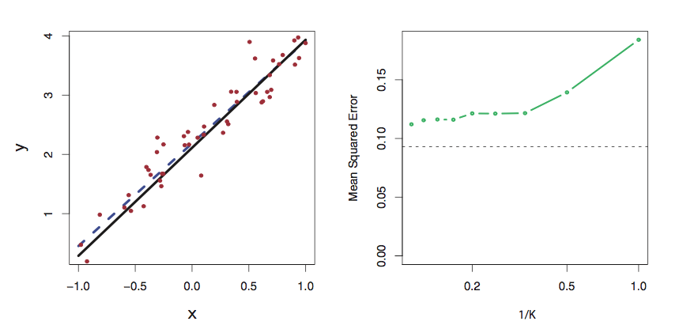
MLR vs k-NN
Now let’s fit a regression model, see the dashed blue line on the left figure
The dashed grey line on the right figure represents the MSE for the regression model
The green line is the MSE of the K-NN model as a function of 1/K
Which method is performing better?
Notes:
The same data set shown in Figure 3.17 is investigated further. Left: The blue dashed line is the least squares fit to the data. Since f(X) is in fact linear (displayed as the black line), the least squares regression line provides a very good estimate of f(X). Right: The dashed horizontal line represents the least squares test set MSE, while the green solid line corresponds to the MSE for KNN as a function of 1/K (on the log scale). Linear regression achieves a lower test MSE than does KNN regression, since f(X) is in fact linear. For KNN regression, the best results occur with a very large value of K, corresponding to a small value of 1/K.

Slide 24
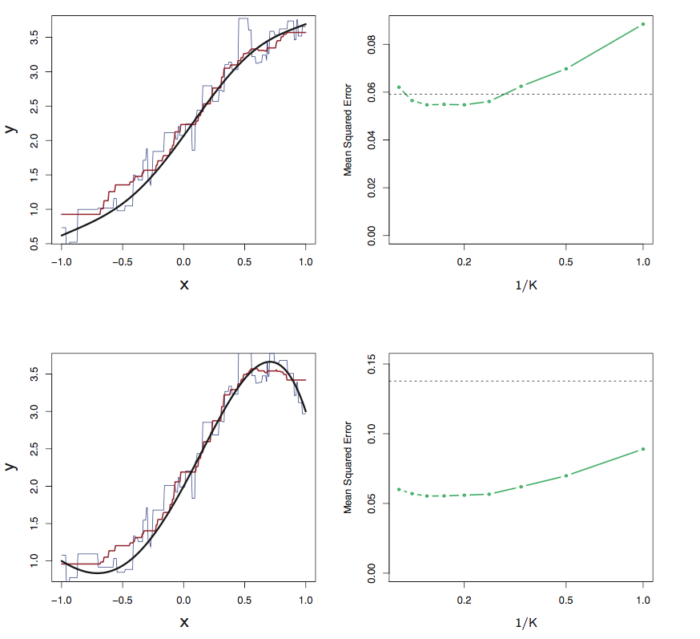
MLR vs k-NN
What if the relationship between x and y is not linear?
The top figures show a case when the relationship deviates from linear slightly
The bottom figures show a case when the relationship is strongly non-linear
Notes:
Top Left: In a setting with a slightly non-linear relationship between X and Y (solid black line), the KNN fits with K = 1 (blue) and K = 9 (red) are displayed. Top Right: For the slightly non-linear data, the test set MSE for least squares regression (horizontal black) and KNN with various values of 1/K (green) are displayed. Bottom Left and Bottom Right: As in the top panel, but with a strongly non-linear relationship between X and Y .

Slide 25
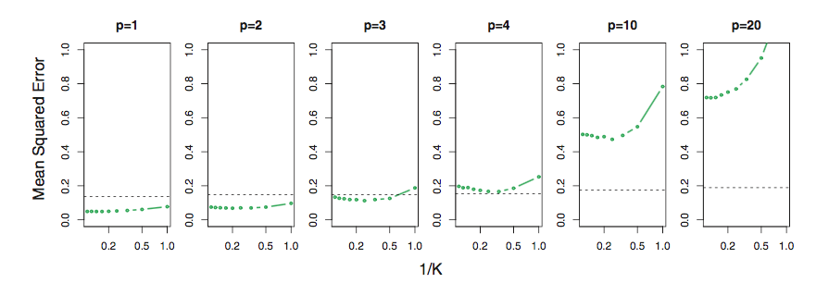
MLR vs k-NN
However K-NN often performs worse than the linear regression in high dimensions
In this experiment we take the last example in the previous slide and add p more explanatory variables that are randomly generated.
As a general rule, parametric methods will tend to outperform non-parametric methods when there is a small number of observations per predictor
What do you observe?
What do you think causes this?
As p increases the number of points you need to have a similar accuracy grows exponentially.
What can we do about this?
Computational shortcuts that settle for “almost nearest neighbors”
Reduce dimension of predictors (e.g., with PCA)

Slide 26
Summary
Advantages
Simple off-the-shelf algorithm that requires very little data processing
No assumptions required about Normal distribution, etc.
Effective at capturing complex interactions among variables without having to define a statistical model
Works easily on multi-class problems
Disadvantages
Low interpretability. It is a black-box algorithm
Required size of training set increases exponentially with # of predictors.
In a large training set, it takes a long time to find distances to all the neighbours and then identify the nearest one(s)
Sensitive to scale of data
Not work well on rare event (skewed) target variable

Slide 27
Today’s agenda
k-NN
Introduction and basics
How to score new data
Distance metrics
How to chose k
Regression vs MLR
Advantages and disadvantages of k-NN
Principal component analysis: Dimension reduction
How to use PCA with regression and k-NN
Notes:
Let’s see where we are in the sylabus

Slide 28
How to use PCA?
In regression models we can replace the original variables with PCA scores
But how do we choose how many of them to use?
There is no statistical test but we look at the variation explained as a function of number of components and we hope that a small number explains most of the variation
The number of principal components can also be chosen by cross validation
For k-NN and other algorithms
We can choose the number of principal components using cross validation
See the rmd file for details

Slide 29
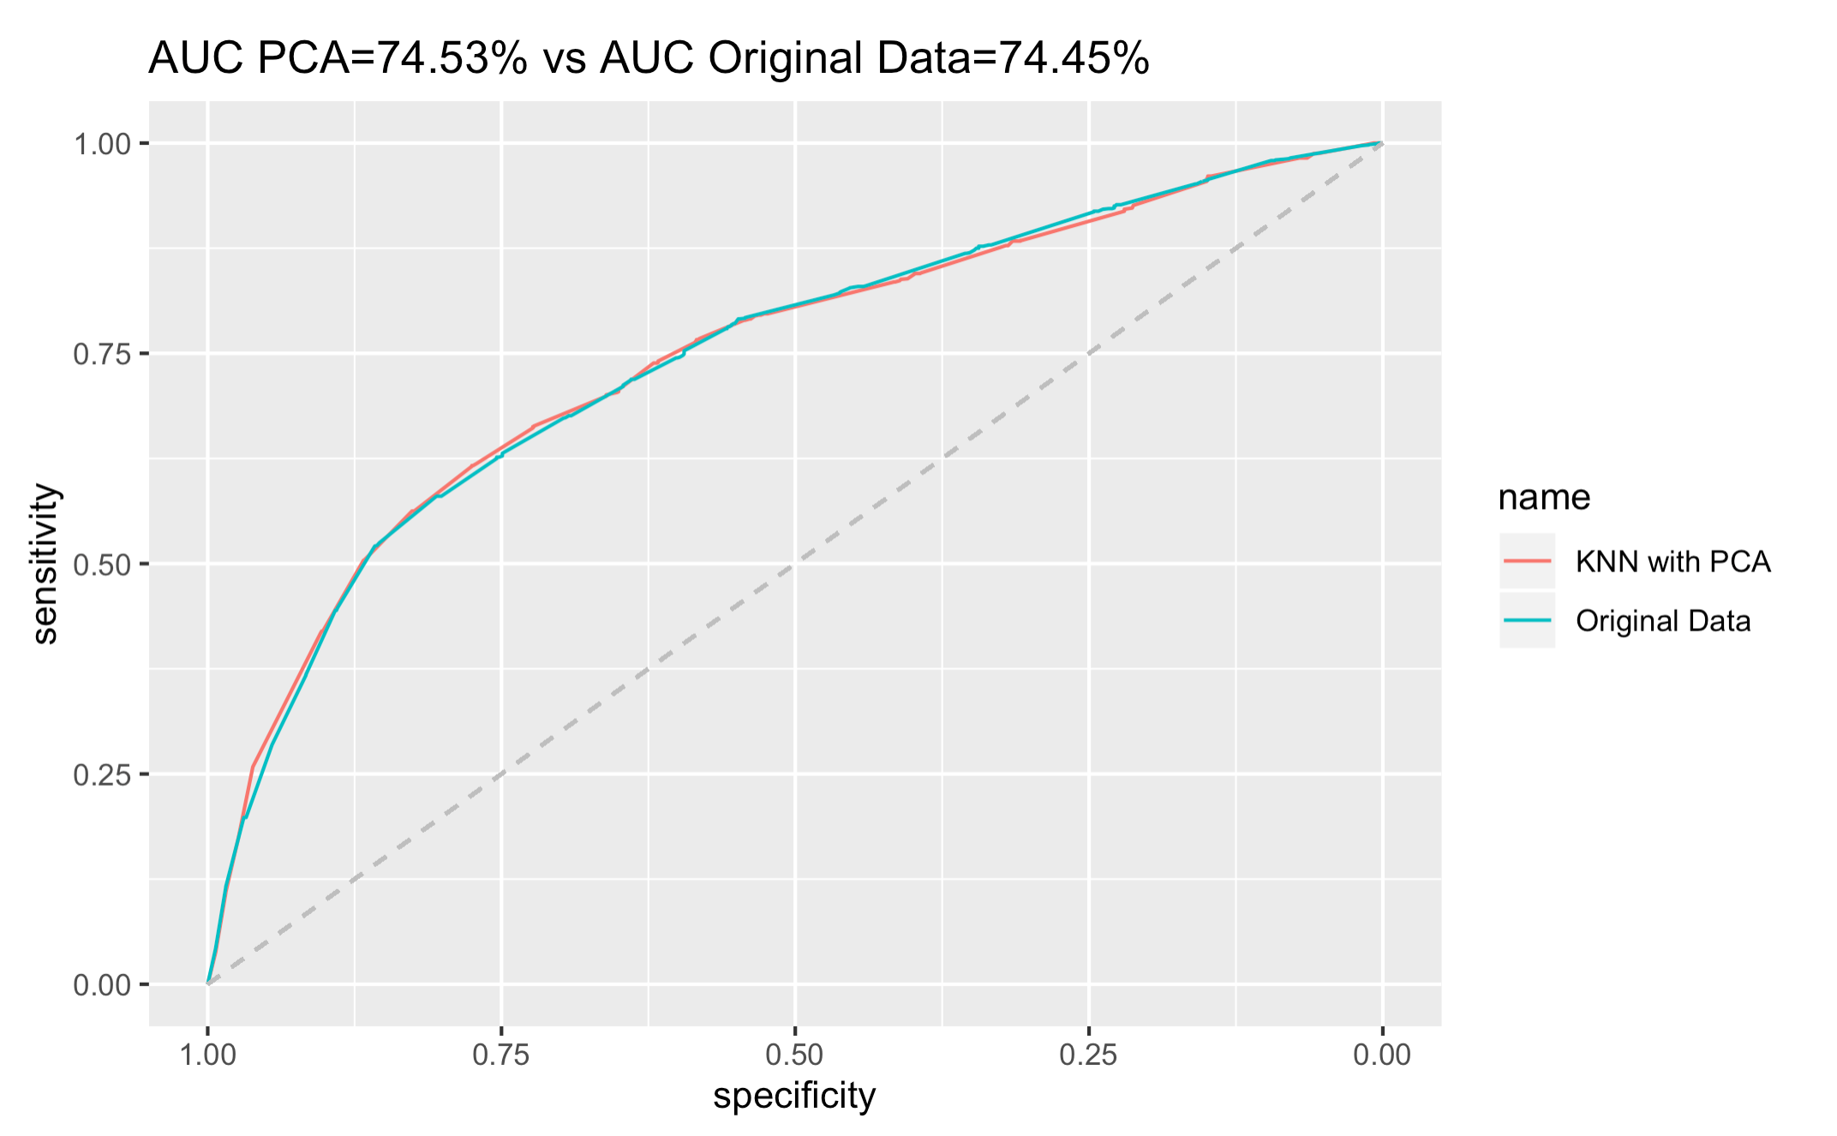
Results

Slide 30
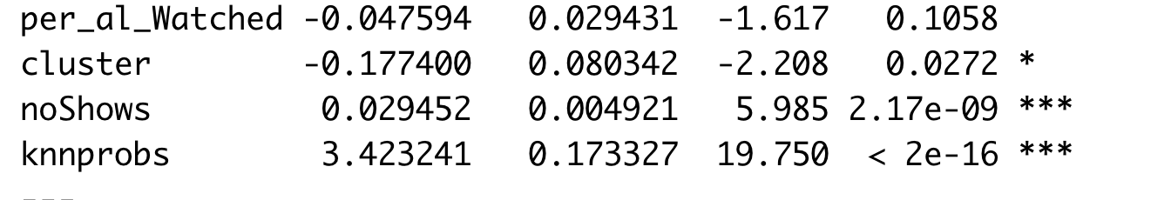
Ensemble methods
Can we combine the results of kNN and clustering with logistic regression model?
Find clusters using K-Means with “best” k
Find estimates of k-NN with best k
Use the results as independent variables in logistic regression in addition to other variables.

Slide 31
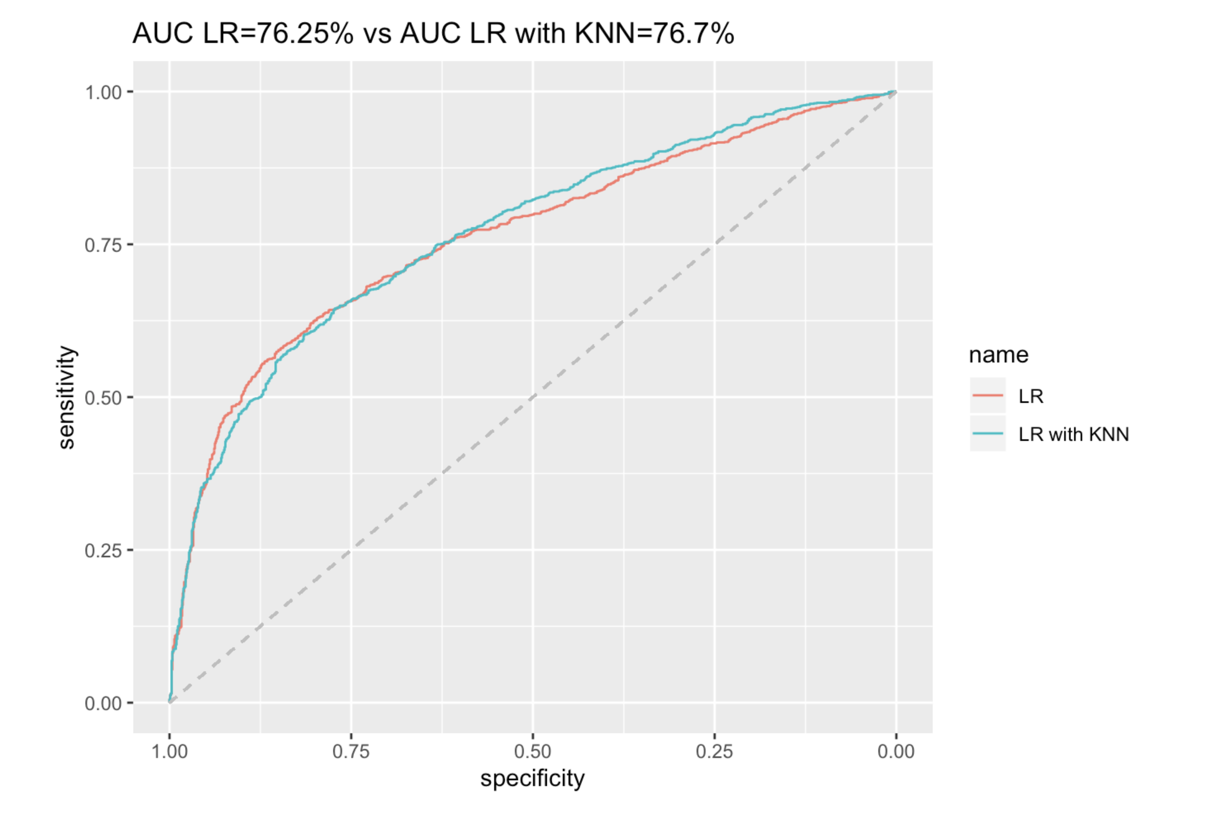
Results

